Slide 1

DEVELOPTHON 2020 Code for Social Impact
Paid Lancers
Suraj Mahendrakar
Akashgouda Hiregoudar
Shubhashini S Patil
RohanKumar B Kappenavar

Slide 2
1. Problem Statement Assigned
Accurate OCR Data extracting from Tiff Images in the following conditions: 1. Extract accurate OCR data from the images which are having Water Marks on it. 2. Handwritten Text to be extracted with accurate OCR data. 3. Poor quality images giving lower accuracy in the final output. 4. Data to be extracted in chronological order.

Slide 3
The given problem statement is solved using Python platform.
Python GUI is used for user interface.
User can upload any formatted images.
User can extract accurate OCR data from the images which are having Water Marks, Handwritten Text, Poor quality images.

Slide 4
Cover Up The 4 Major Points as Listed Below
Converting .tiff images into .jpg format and extracting data present in images using python built-in packages.
Python, Machine Learning.
Easy to read tiff images containing watermark, handwritten and poor quality images.

Slide 5
Your
Impact

Slide 6
As everything is being digitalized nowadays, our project will help society to convert their hardcopy to softcopy of data.
We can use this project in different fields like hit and run case.

Slide 7
DESKTOP PROJECT

Slide 8
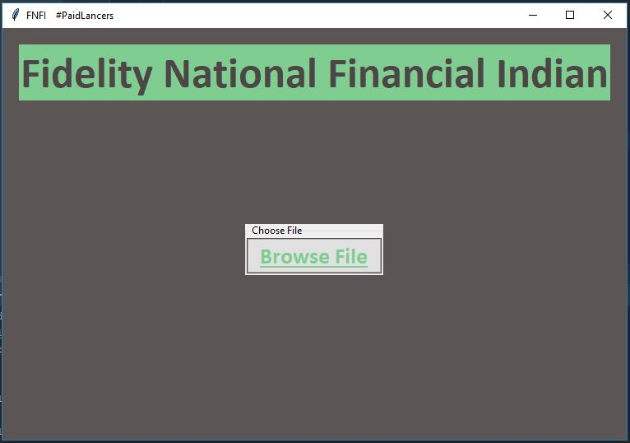

Slide 9
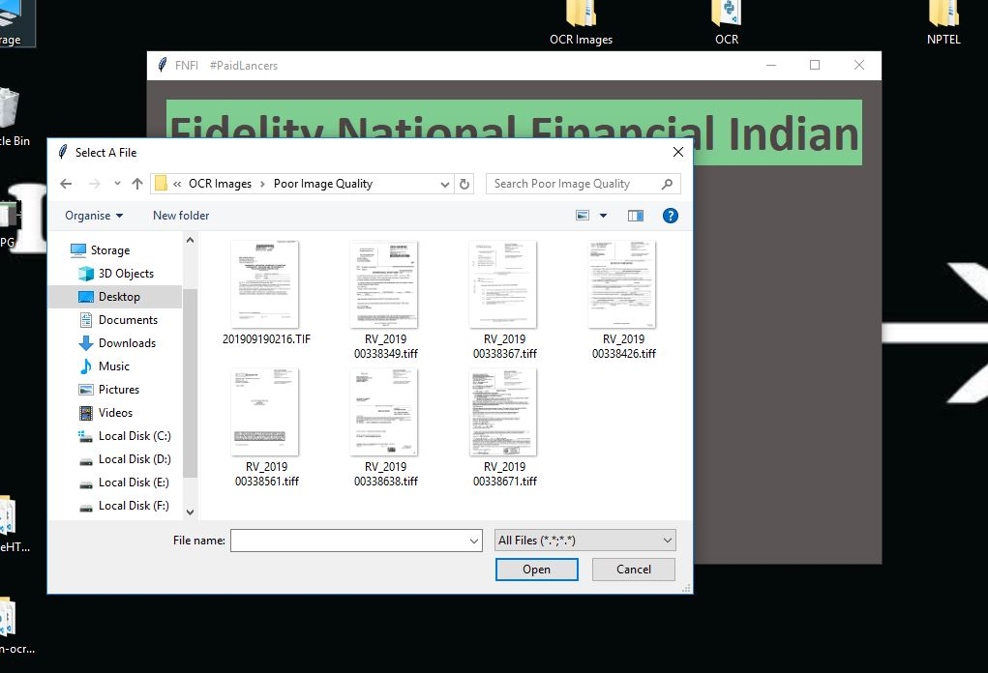

Slide 10
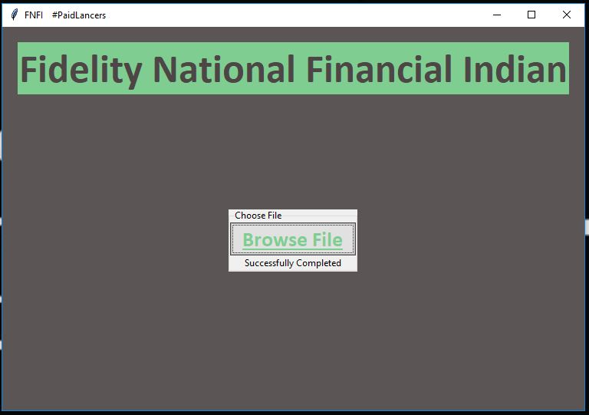

Slide 11
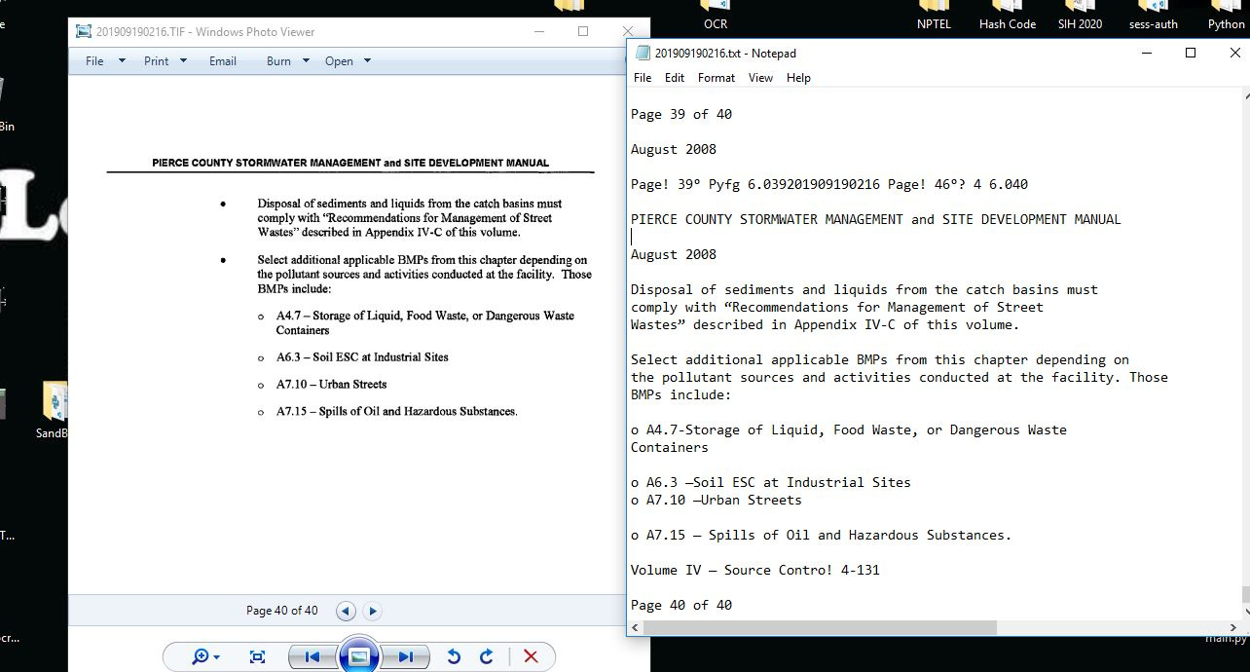

Slide 12
THANK YOU!!

